Slide 1
Information System Innovation
Ahmad Adzin Brillian L. K
Hammam Abdulllah Saeed B. G
M. Atho’illah Mu’thisyah
M. Taqqiyuddin tsaqif
Ridho Anfa’al

Slide 2
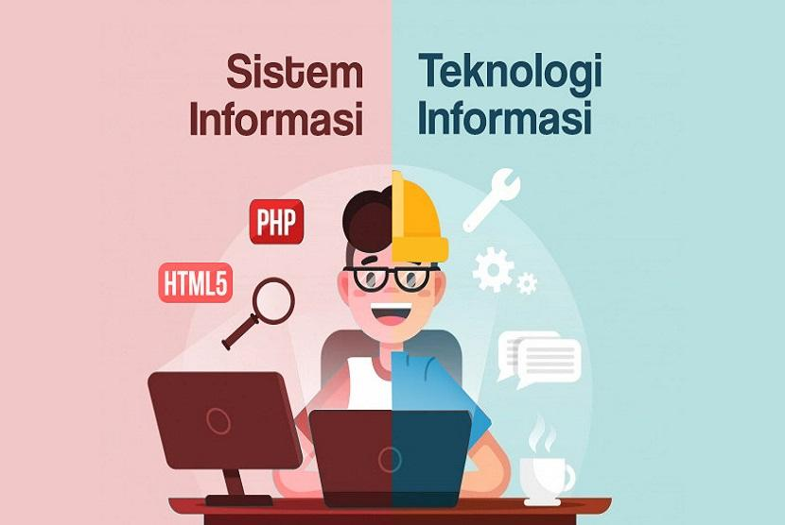
What is the difference between information systems innovation and information technology ?
Information system innovation involves identifying, designing, and implementing changes in existing information systems or creating new, more effective, efficient, or value-added information systems. Its primary focus is on improving or transforming how businesses use information technology to achieve strategic and operational goals. This involves changing business processes, workflows, and using technology more effectively to meet business needs.
Information technology refers to various technologies, devices, software, infrastructure, and computer systems used to collect, store, manage, and communicate data and information. Information technology is the foundation that enables information systems to operate and evolve.

Slide 3



Explanation of E-commerce
Electronic commerce or e-commerce is a process of buying and selling transactions which in practice are carried out online via electronic media. According to Laudon & Laudon, e-commerce is a business to business transaction that occurs through the internet network.
In the world of commerce, e-commerce offers many changes. The buying and selling process no longer requires face-to-face meetings like in conventional stores. Sellers and buyers only need to process transactions online.
Currently, the means of e-commerce are not only via telephone and television, but now more often use the internet. Some people confuse marketplace with e-commerce and think they are the same. In fact, the meaning of e-commerce is different from marketplace.
Meanwhile, another form of e-commerce is in the form of a website or online shop application owned by a brand, company or home business.

Slide 4
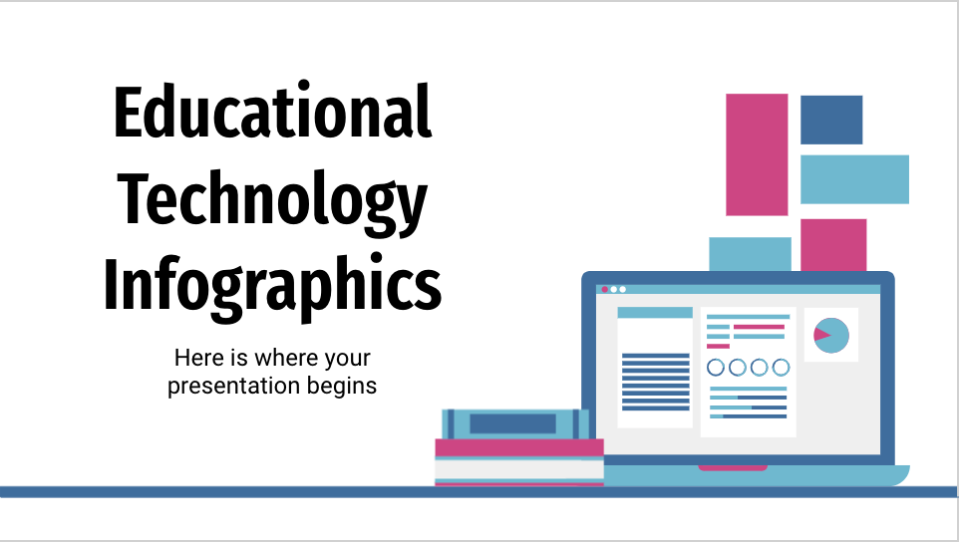
What improvement has been made?
Increase in population
The biggest factor causing the increase in e-commerce use is the high population growth rate in Indonesia.
Smartphone users are increasing
The smartphone industry in Indonesia has provided the best innovation so that everyone can access the internet.
Internet users are increasing
Even when making payments on the marketplace, smartphone users dominate by almost 75%, compared to online transactions via laptop or PC.
Many social media users
Generally, purchasing goods in e-commerce is also influenced by the marketing strategies carried out by sellers on social media. Therefore, the large number of social media users in Indonesia has a big influence on increasing the rate of e-commerce.

Slide 5
Target Audience of Our E-Commerce System
Primary Audience: Individual consumers seeking diverse products, including clothing, electronics, and home goods.
Demographics: Focus on ages 25-45, diverse income levels, urban and suburban residents.
Global Reach: Expanding beyond North America to serve a worldwide audience.
Secondary Focus: Businesses (B2B) requiring bulk orders, such as retailers, restaurants, and SMEs.
Niche Markets: Addressing specific interests like outdoor enthusiasts, gamers, and pet owners with tailored products.
Digital Products: Offering e-books , software, and digital content for tech-savvy customers.
Geographic Reach: Adapting offerings to local preferences and languages for a global presence.
Subscription Services: Providing subscription models for exclusive content and benefits.

Slide 6

+/- Impact
Positive Impact
Negative Impact
Still prone to online fraud
Loss of privacy or theft of personal data
Service disruption
Loss of trust from consumers
Wider market reach
Increase income and reduce the risk of other costs
Maximum service to consumers
Ease and flexibility of shopping
Improved supplier management

Slide 7
Ethical Issues Concerning E-commerce
Brave markets, or e-commerce, also have various ethical issues that need to be considered. Some ethical issues in bold markets include:
1. Personal Data Security
2. Online Fraud
3. Fake Reviews and Feedback
4.Consumer Protection
5. Inventory Management
6. Intellectual Property Rights Awards
7. Inequality in Access
8. Tax Regulations and Compliance
9. Environmental Impact

Slide 8

Conclusion
Innovation in information systems and information technology has brought about significant transformation in how we manage information and conduct business, offering new opportunities and enhancing efficiency. However, it has also raised critical issues related to privacy, security, and ethics that must be carefully addressed. In the context of e-commerce, innovation has provided benefits such as convenience and efficiency in shopping, but it has also raised concerns about ethical and data security issues. Therefore, continuous monitoring and adaptation to technological developments are crucial for organizations and individuals to remain relevant and competitive in the current digital era.

Slide 9


